Slide 1
SURA Presentation
Michael, Alvin, Octavio, Freeman....

Slide 2
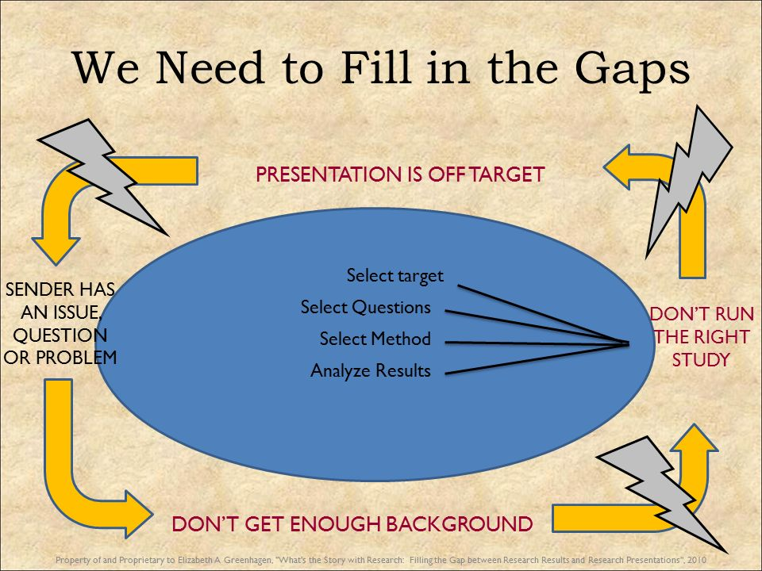

Background
Goal: Use advance machine learning methods to quickly classify studies based on titles and abstracts to quickly identify controlled experimental studies in the fields of agricultural and nutritional research.
Notes:
There has been an increasing need to synthesize knowledge from research to help decision-makers with filling research gaps and quickly accessing high impact, experimental studies. Some bibliographic databases index research based on study design to aid in the finding of experimental research and controlled trials, but this process is time-consuming and often lags behind the pace of research. Systematic methods can be used to conduct comprehensive, reproducible literature reviews, but these still largely rely on manual screening by teams of researchers to identify studies that meet certain criteria.

Slide 3
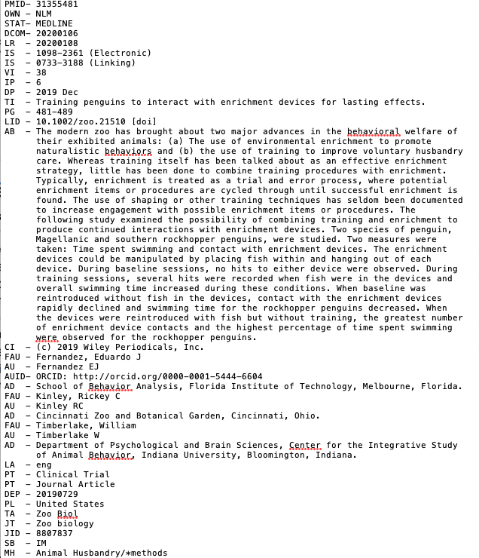
Data:
Medical
Notes:
A training dataset was obtained from the well-indexed biomedical literature (Medline). Medline indexes published research based on study design using ​Medical Subject Headings (MeSH),​ a hierarchical controlled vocabulary applied at the article level. The Publication Type "Clinical Trial" includes research reporting on all phases of clinical trials, as well as randomized control trial studies.

Slide 4
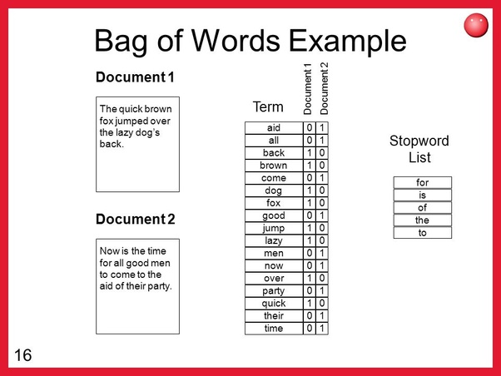
Bag of Words
What is bag of words?
A data frame with words as attribute and each attribute can be boolean or numerical(integer)
How did we implement it in the code?
Get the combined wordlist of all the texts(attributes) and create a dataframe where for each article, if its text has a word in the wordlist, that grid is assigned 1, otherwise 0.

Slide 5
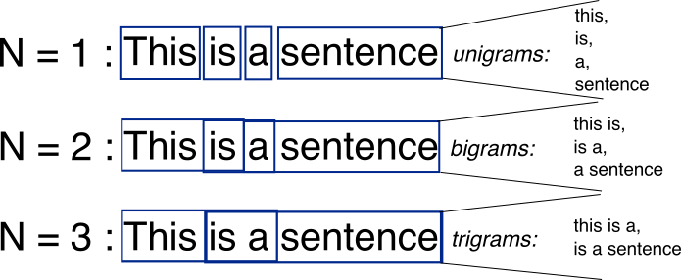
Bag of bigrams
Similar to bag of words, one word = unigram

Slide 6
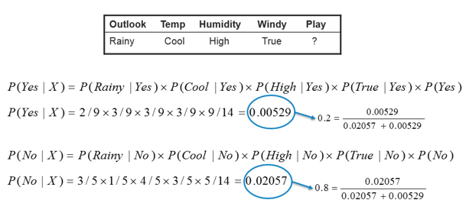
Naive Bayes
R Library/Packages: naivebayes
Generate probability distribution for each label class using parameters estimated by the attributes.
Notes:
Assumption: Each attribute are independent
In this case: Play is our response and it’s a binary variable with classes Yes/No

Slide 7
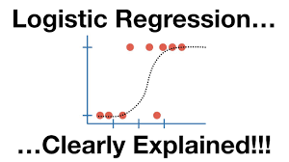
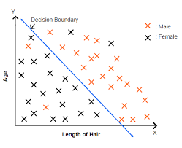
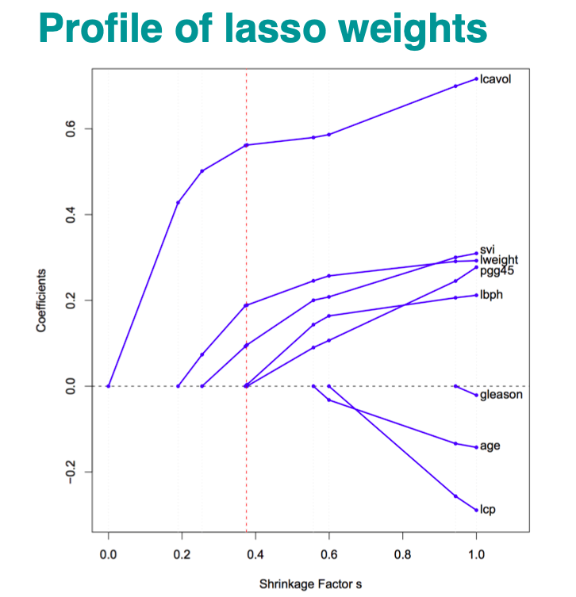
Logistic regression with Lasso
R Library/Packages: glmnet
Logistic Regression: Model the probability of a class and classify by a linear decision boundary
Lasso: Add penalty to the regression model to prevent overfitting
Notes:
Reduce some of the parameters to 0.

Slide 8
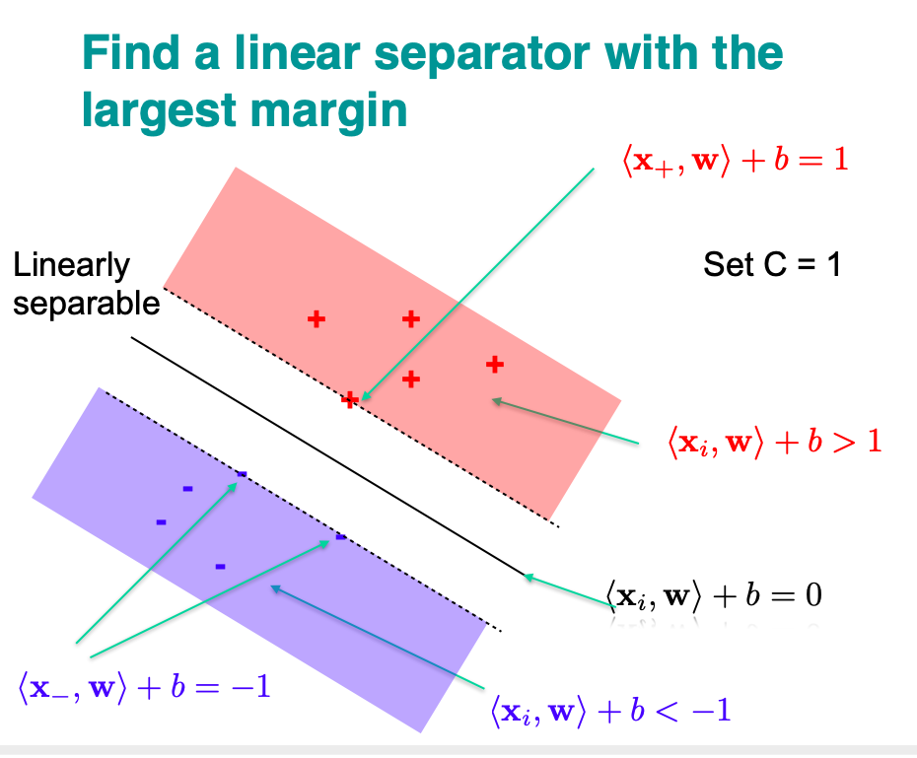
Support Vector Machine
R Library/Packages: e1071
Similar to logistic regression(Linear decision boundary)
If not linear separable, soft margin can be used.
Notes:
Optimal decision boundary that finds the sweet spot, same distance to all class clusters.(Using gradient descent)

Slide 9

Decision Forest
R Library/Packages: randomForest
Description: Ensemble method of decision trees i.e. Combining predictions of multiple decision trees.
Decision tree: Predictive model that recursively partitions the attribute space into subspaces such that each subspace constitutes a basis for a different prediction function

Slide 10
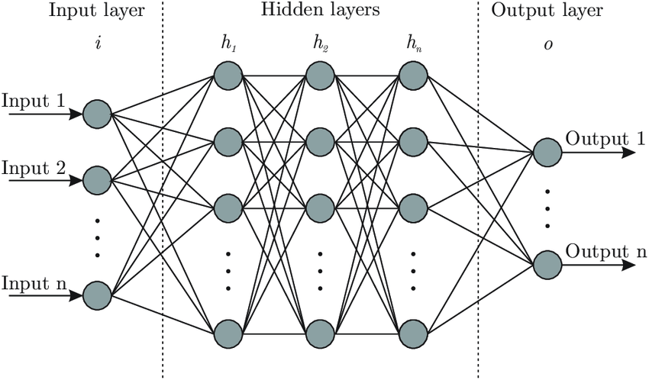
Neural Networks
R Library/Packages: neuralnet
A set of algorithms, modeled loosely after the human brain, that are designed to recognize patterns.
*It can estimate any function by theory.
Notes:
Trained using gradient descent with the help of chain rule
Usually more hidden layers performs better but takes longer to compile. In our case the output layer only has one unit since our response is binary.

Slide 11

K-Folds Cross Validation

Slide 12
Performance:
 | DF | SVM | NB | Lasso | NN
Train Efficiency | Very Slow | Moderate | Fast | Fast/Slow (Converge) | Moderate
Predict Efficiency | Moderate | Fast | Slow | Fast | Moderate
Accuracy | HIGH | HIGH | Satisfactory | Satisfactory | Satisfactory
Overfit | No | No | No | No | No

Slide 13
Results
Title(Bag of words)
 | Decision Forest | SVM(linear) | Naive Bayes | Logistic with Lasso | Neural Networks
CV error | 6.108% | 3.835% | 8.327% | 8.327% | 8.327%
CV sd | 1.182% | 0.567% | 1.467% | 1.467% | 1.467%
Abstract(Bag of bigrams)
 | Decision Forest | SVM(linear) | Naive Bayes | Logistic with Lasso | Neural Networks
CV error | 3.185% | 4.517% | 8.743% | 8.801% | 8.801%
CV sd | 0.543% | 0.763% | 0.981% | 1.022% | 1.022%
Notes:
The only numbers on this page that are important are the CV errors. To not overwhelm the audience, I think you should delete the other numbers.

Slide 14
Interesting observation
Neural net & Lasso give the same errors
Possible reason: Neural net estimates Logistic with Lasso penalty in this case

Slide 15
Summary
All models give satisfactory accuracies
SVM is the best model considering all aspects
Possible improvement: Bag of words with word frequency counts might be give better results using Neural Nets

Slide 16
Questions?

